Slide 1
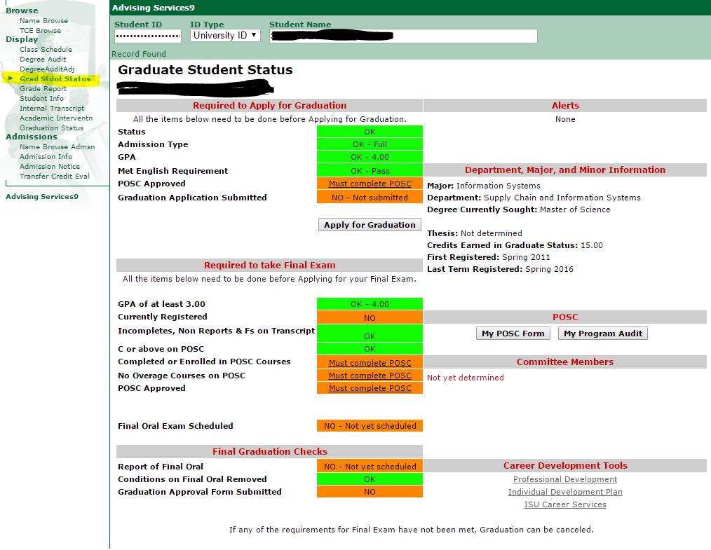
Graduate Student Status Page in Access
Plus

Slide 2
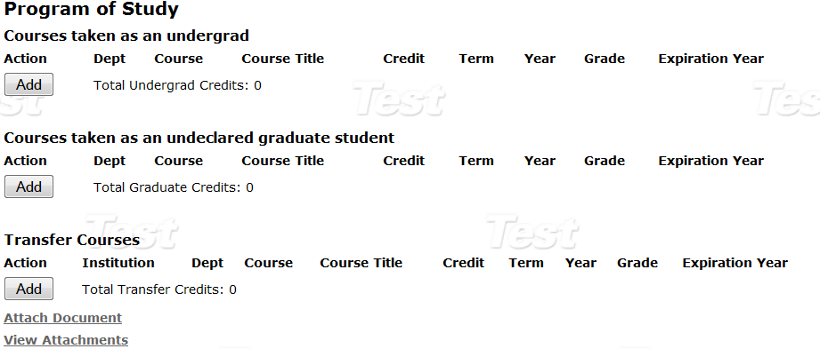
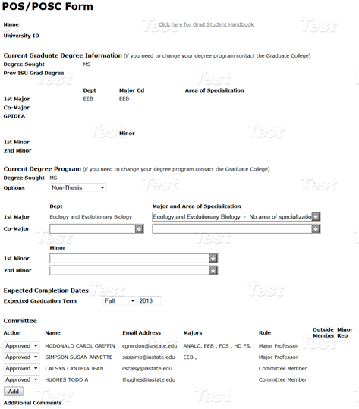
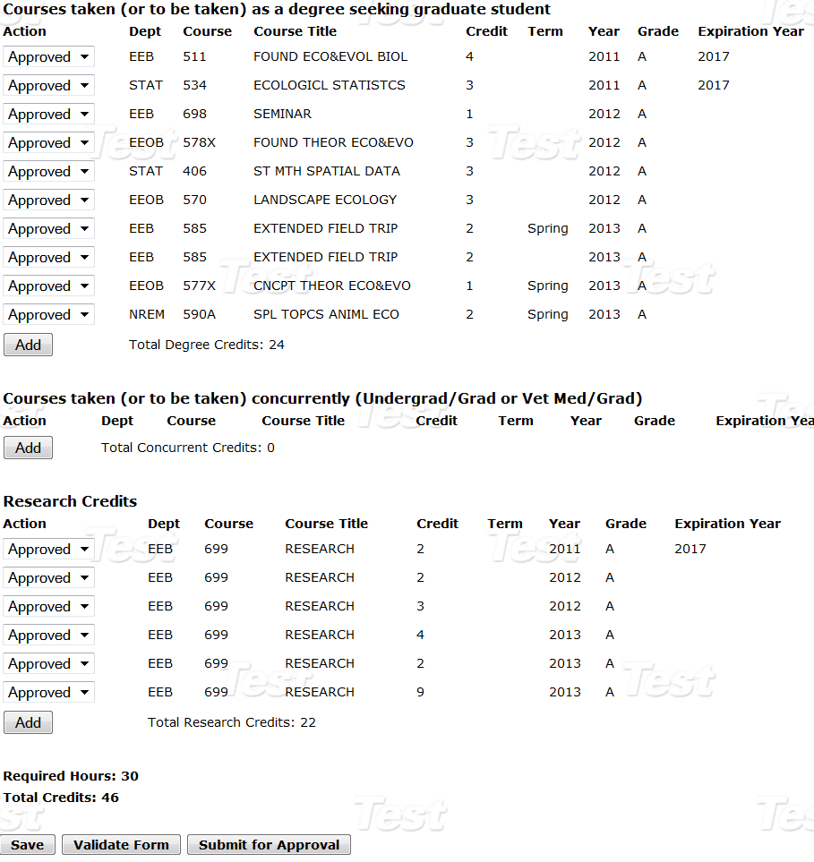
Program of Study Committee Form

Slide 3
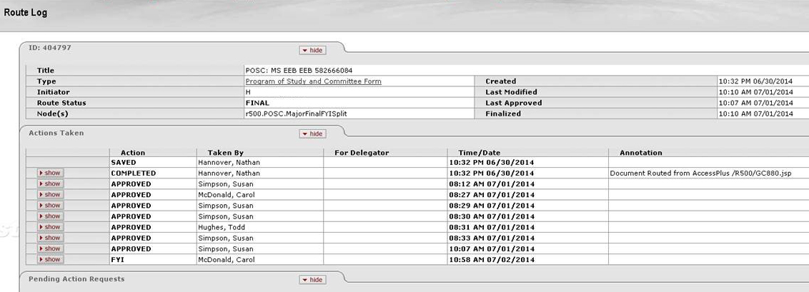
POSC Routing Log
Routing Log will appear in the top portion of the student’s My POSC page when
form is in routing.
After the form is approved, the routing log will disappear.

Slide 4
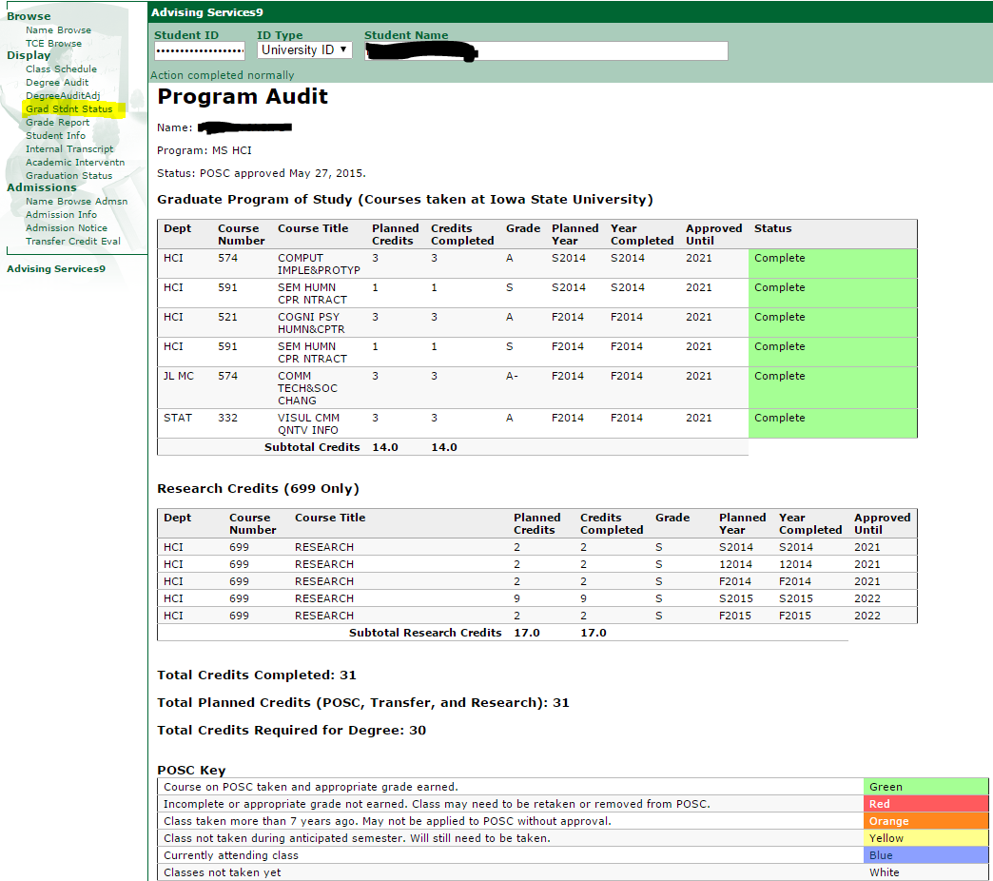
POSC Audit
Student/major professor/staff will have access to approved POSC
Graduate Student Status Page in AccessPlus –
MY PROGRAM AUDIT
Color alerts
Links to make changes

Slide 5
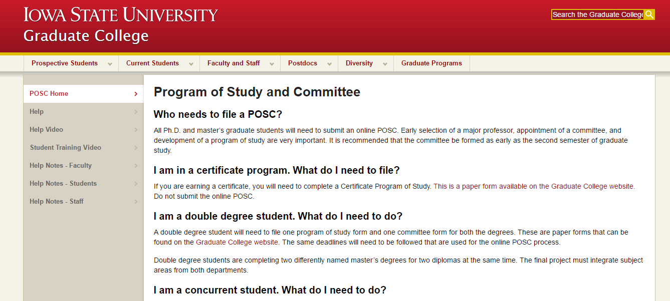
Where can students go for online help?
Graduate College/Current Students/Program of Study (POSC)
http://www.grad-college.iastate.edu/posc/

Slide 6

POSC Routing Process (signatures)
Routing must be approved at
each level before it goes to
next approval stage
Student - submit
Department (FYI)
Major Professor
Committee Members
DOGE
Graduate College
Automatically update Access Plus and ADIN

Slide 7
Next Steps
Check the routing of your POSC in My POSC.
Contact your major professor or committee members, if needed, and remind them to approve.
Be aware of any deadlines for graduation
Contact you Graduate Program Office if you have questions or problems.

Slide 8
Questions
Contact Natalie Robinson, nbr@iastate.edu
http://www.grad-college.iastate.edu/common/POSC/index.php

