Slide 1
What do Graduate Faculty Members need to do?
Talk to graduate students regarding committee members and classes on POSC.
Look for an e-mail from “Solution Center” that indicates a POSC form to process.
Go into AccessPlus. Look at the ‘In basket’, select ‘Kuali Action List.’ If it doesn’t appear on the main page, it can be found on the uBusiness tab.
Review the POSC information. Make comments as needed.
Approve or disapprove the form. If you disapprove the form, you must write a Reason for Disapproval and sign your name to the message.

Slide 2
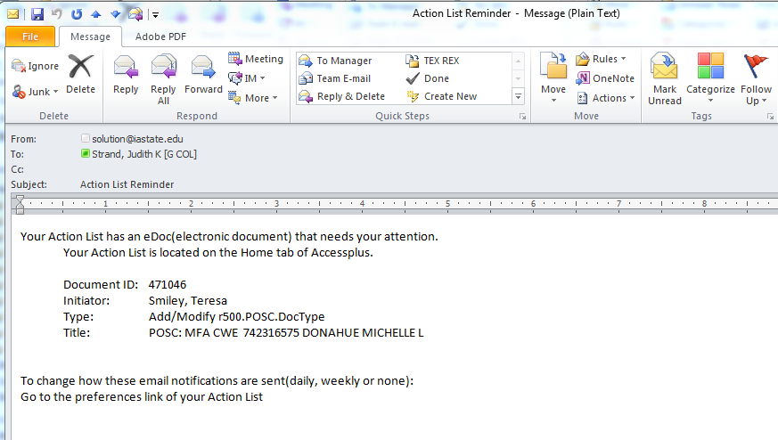
Faculty/Staff e-mail notification from the Solution Center
Student ID and Name

Slide 3
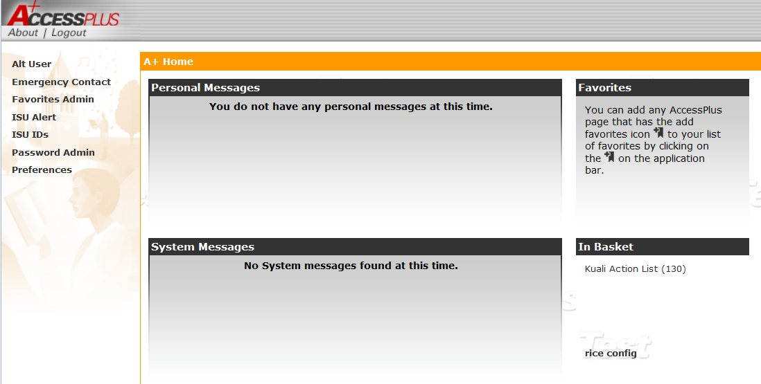
Faculty/Staff Information
AccessPlus – Home or uBusiness tab

Slide 4
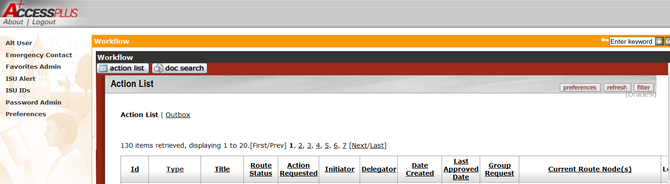
Action List
Click on the ID number to bring up the student’s form.
The form will take about 30 seconds to load. It seems like a long wait.

Slide 5
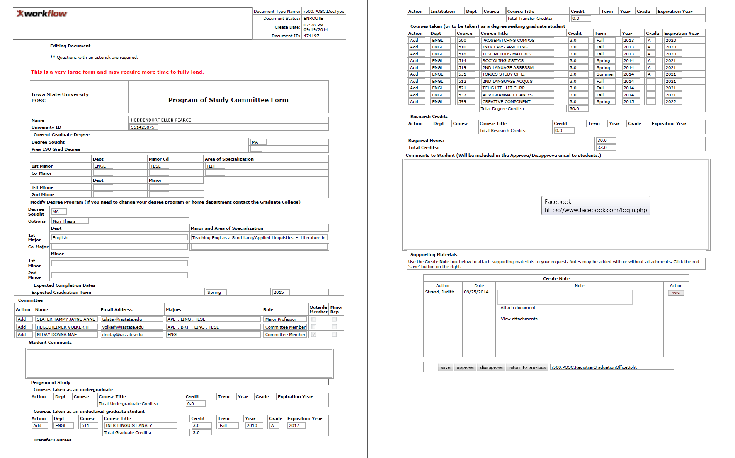
POSC Approval Form
Student name Student ID
POSC form as viewed by approvers

Slide 6
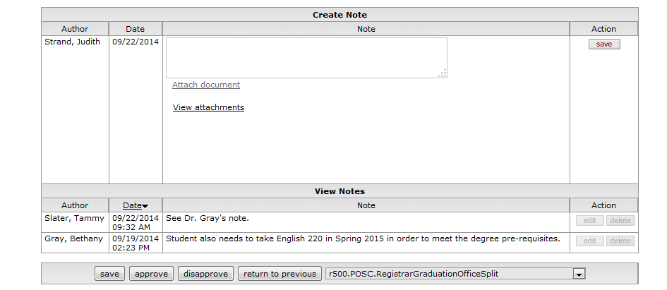
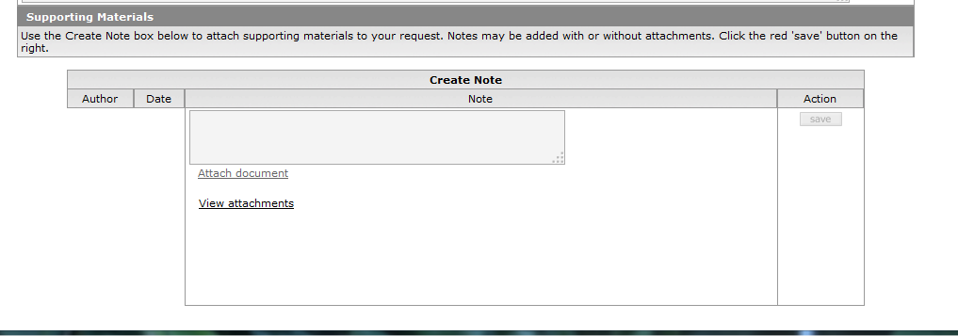
How do you approve?
Save allows you to save the form/comments and come back to it.
Approve sends the form on to the next approver. The choices at on the bottom of the form go away.
Disapprove goes back to the student.
Return to previous goes
back to a previous approver (not the student).
Notes in the lower section will not be seen by students.
Before approval
After approval

Slide 7
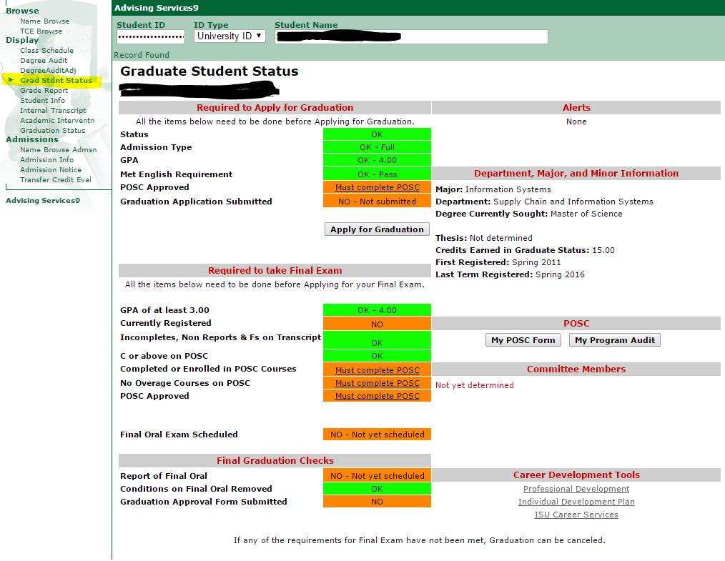
Graduate Student Status Page in Access
Plus

Slide 8
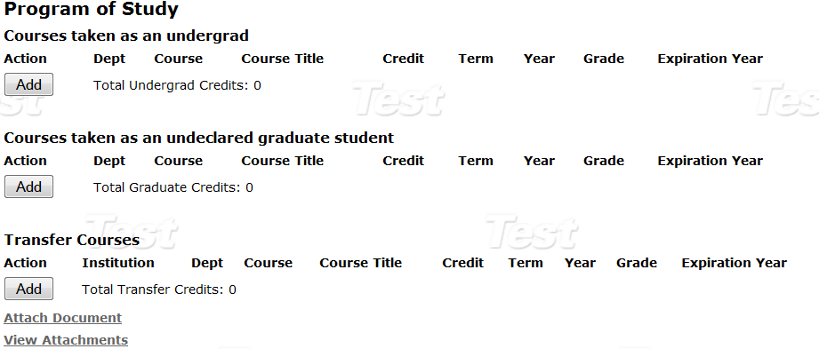
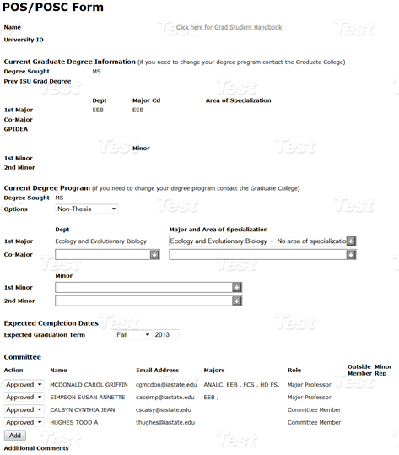
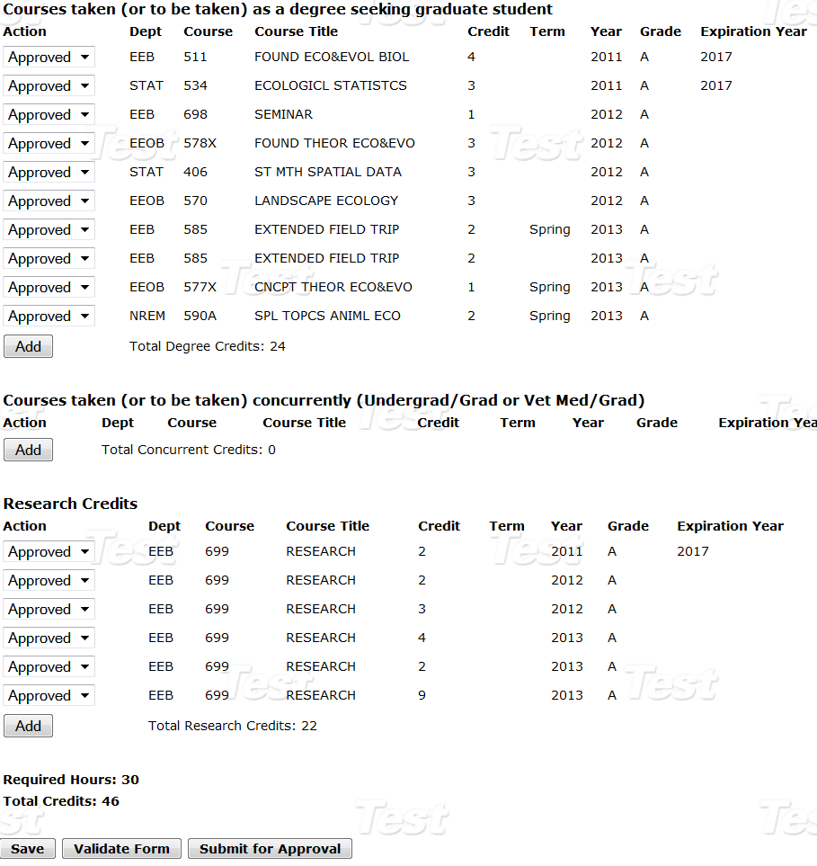
Program of Study Committee Form

Slide 9

POSC Routing Process (signatures)
Student
Department (FYI)
Major Professor
Committee Members
DOGE
Graduate College
Automatically updates Access Plus and ADIN

Slide 10
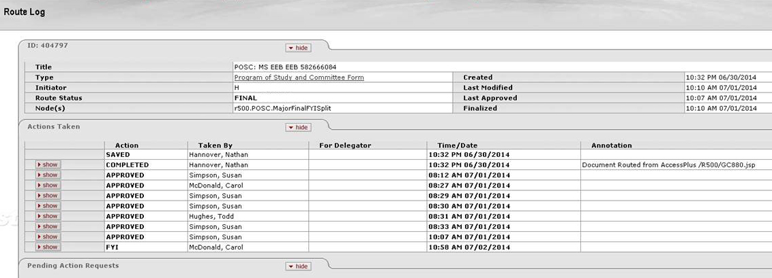
POSC Routing Log
Routing Log will appear in the top portion of the student’s My POSC page when
form is in routing.
After the form is approved, the routing log will disappear.

Slide 11
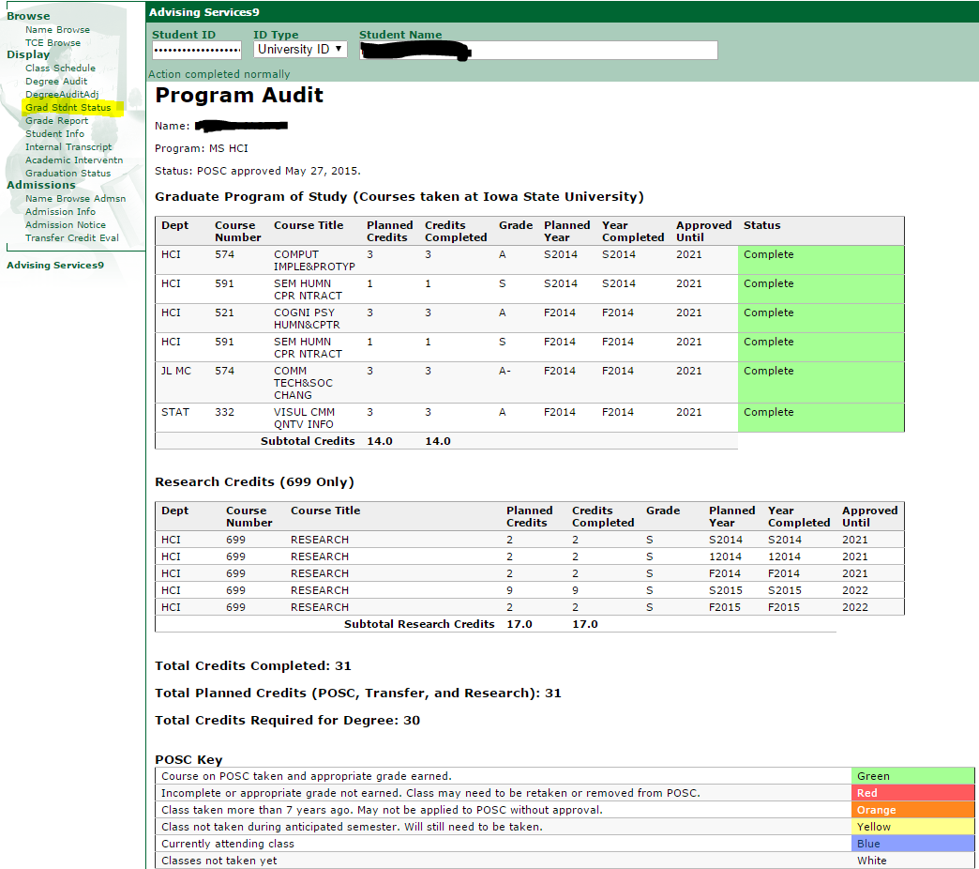
POSC Audit
Student/major professor/staff will have access to approved POSC
Graduate Student Status Page in AccessPlus –
MY PROGRAM AUDIT
Color alerts
Links to make changes

Slide 12
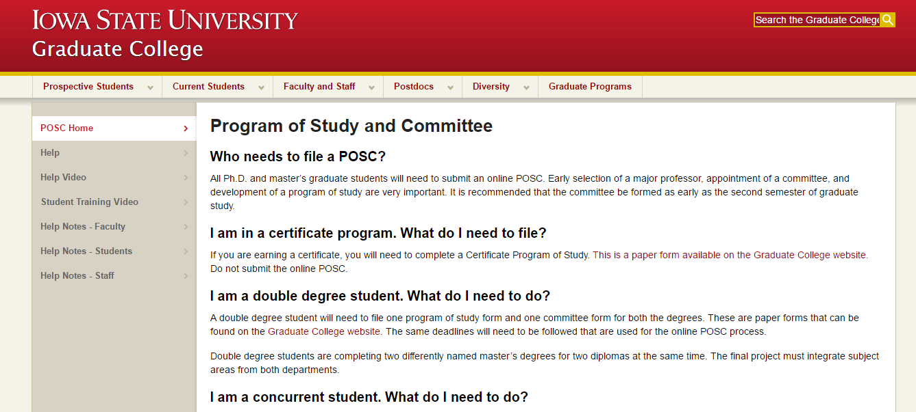
Where can students go for online help?
Graduate College/Current Students/Program of Study (POSC)
http://www.grad-college.iastate.edu/posc/

Slide 13
Questions
Contact Natalie Robinson, nbr@iastate.edu or Judy Strand, jstrand@iastate.edu
Graduate College POSC Powerpoint.

